Slide 1
Statistics for Analytics (BAN 100)
Assignment 6
by : Aaron Gonsalves
(161288196)

Slide 2
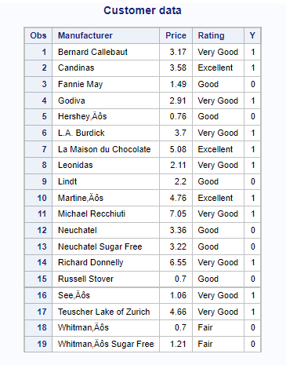
CODES
PROBLEM 1
proc import datafile = '/home/u58712040/BAN100/files/Customer.xlsx'
out = Customer
dbms = xlsx
replace;
getnames=yes;
run;
data Customer;
set Customer;
if lowcase(Rating) in ('very good', 'excellent') then Y=1;
if lowcase(Rating) in ('good', 'fair') then Y=0;
run;
title"Customer data";
proc print data=Customer;
run;

Slide 3
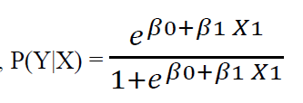
a) Write the logistic regression equation relating x = price per serving to y.
β0 is the intercept and β1 is the coefficient of X1.

Slide 4
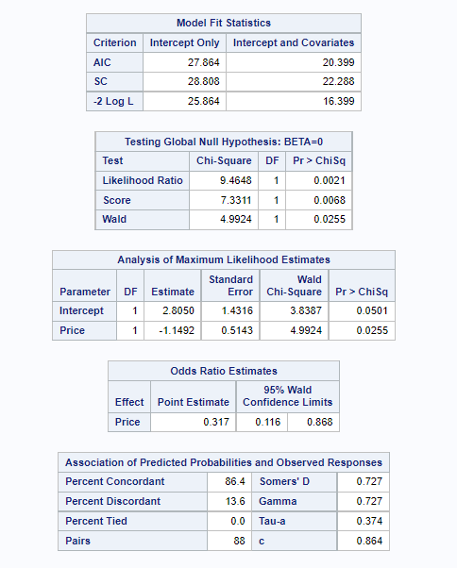
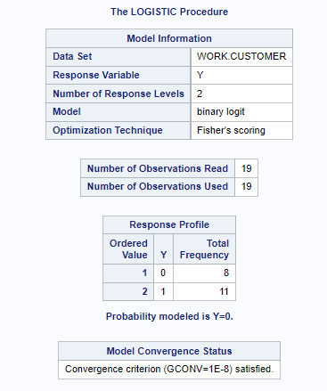
b) Use SAS to compute the estimated logit.
CODES
proc logistic data=Customer;
model y = Price;
run;

Slide 5
The coefficient of Price, β1 is -1.1492
The intercept, β0 is 2.8050
From the above procedure, it is clear that our model is built for level 0.
So, the value that we get from the equation represents the probability of the quality rating ‘good’ or ‘fair’.

Slide 6
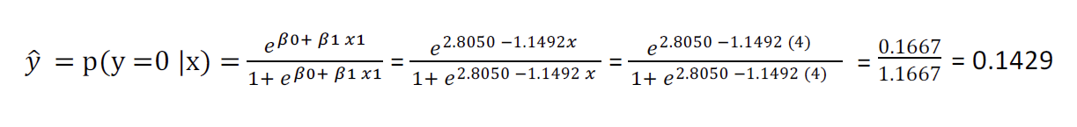
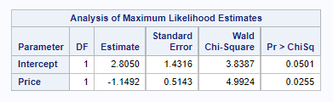
c) Use the estimated logit computed in part (b) to compute an estimate of the probability a chocolate that has a price per serving of $4.00 will have a quality rating of very good or excellent.
= 14.29 %

Slide 7
14.29% shows the probability of a chocolate that has a price per serving of $4.00 will have a quality rating ‘good’ or ‘fair’.
The probability of a chocolate that has a price per serving of $4.00 will have a quality rating of ‘Very good’ or ‘Excellent’
= 1-0.1429 = 0.8571 =85.71%

Slide 8
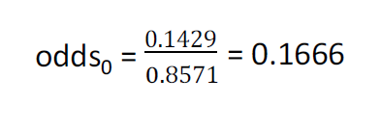
d) What is the estimate of the odds ratio? What is its interpretation?
The probability of a chocolate that has a price per serving of $4.00 will have a quality rating ‘good’ or ‘fair’ is 14.29%
The probability of a chocolate that has a price per serving of $4.00 will have a quality rating of ‘Very good’ or ‘Excellent’ is 85.71%

Slide 9
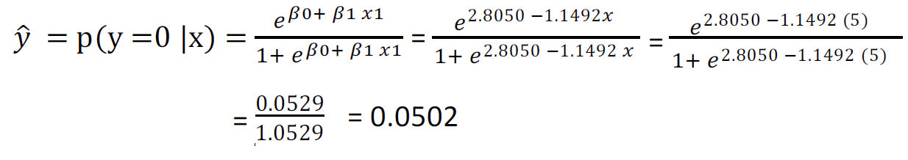
Increasing Price to $5.00
The probability of a chocolate that has a price per serving of $4.00 will have a quality rating ‘good’ or ‘fair’ is 5.02%
The probability of a chocolate that has a price per serving of $4.00 will have a quality rating of ‘Very good’ or ‘Excellent’ is 94.98% (1-0.0502)

Slide 10
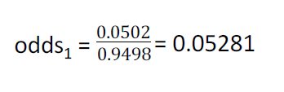



Slide 11
Interpretation
The odds of Chocolate quality rating ‘good’ or ‘fair’ over quality rating of ‘Very good’ or ‘Excellent’ is 5% / 94% that is 0.0581
The Odds Ratio for Price is 0.317, 95% and the Confidence interval is 0.116 to 0.868
The odds for both events are the same, if the value of the odds ratio is 1.
A ratio of odds greater than 1 infers that there are greater odds of the event happening versus the non-happening.
A ratio of odds less than 1 infers that there are lesser odds of the event happening versus the non-happening.
The odd ratio is 0.317 here, which is less than 1 and thus, infers that the odds for Chocolate quality rating being ‘Good’ or ‘Fair’ is lesser than the odds of quality rating being ‘Very Good’ or ‘Excellent’.

Slide 12
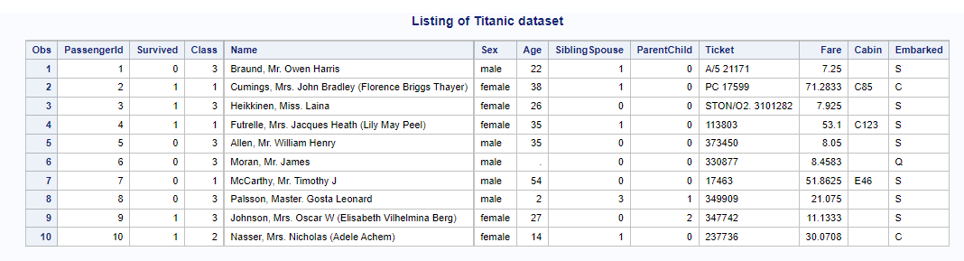
PROBLEM 2
CODES
proc import datafile = '/home/u58712040/BAN100/files/titanic.csv'
out = Titanic
dbms = CSV
replace;
getnames=yes;
run;
title "Listing of Titanic dataset";
proc print data=Titanic(Obs=10);
run;

Slide 13
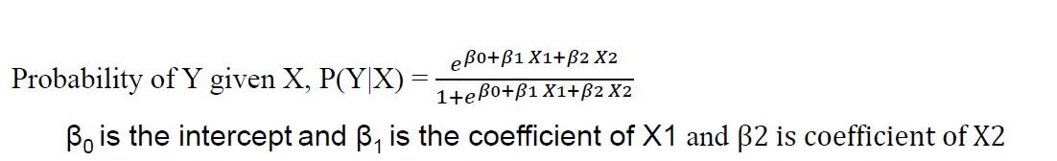
a) Write the logistic regression equation relating Class and Survived.
β0 is the intercept and β1 is the coefficient of X1 and β2 is the coefficient of X2
Dependent Variable
y=1 i.e. passenger was survived
y=0 i.e. passenger was not survived
Independent Variable
Class - First, Second & Third class passengers (1, 2 & 3 )

Slide 14
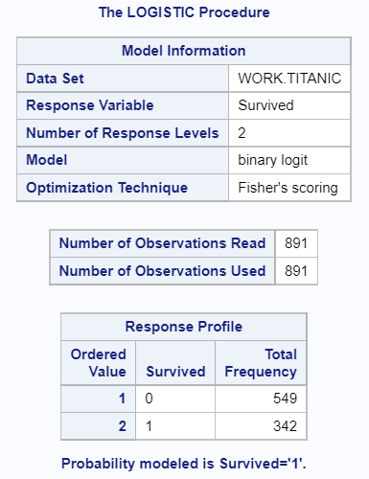
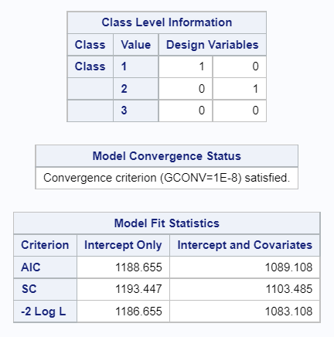
b) For the Titanic data, use SAS to compute the estimated logistic regression equation.
CODES
proc logistic data=Titanic;
class Class param=ref;
model Survived= Class;
run;

Slide 15
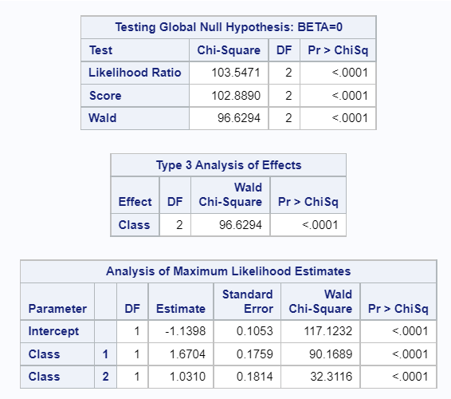
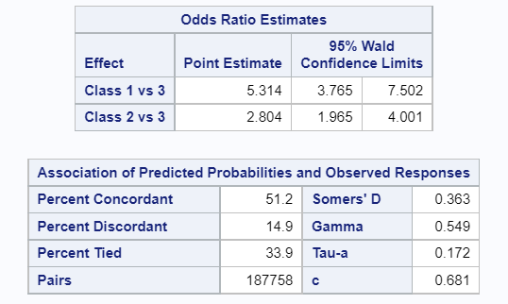

Slide 16
The coefficient of Class 1 i.e., β1 is 1.6704
The coefficient of Class 2 i.e., β1 is 1.0310
The value of intercept, β0 is -1.1398
From the above procedure, it is clear that our model is built for level 0.
So, the value we get from the equation shows the probability of the passenger who did not survive.

Slide 17

c) What is the interpretation of $E(y)$ when $x_{2}=2?$
Estimated probability that a passenger in second class will survive.

Slide 18
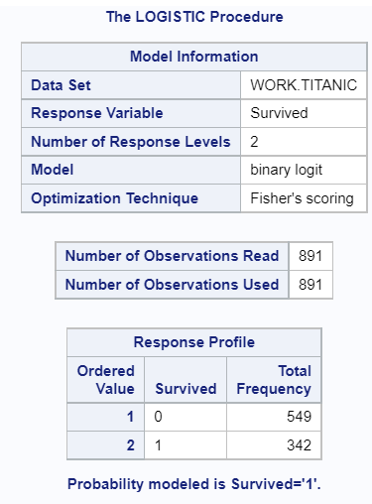
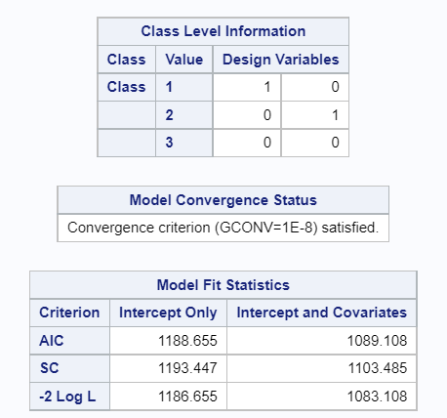
d) Estimate the probability of surviving the 2nd class passengers and the 3rd class passengers.
CODES
proc logistic data=Titanic;
class Class (ref='2' ref='3') / param=ref;
model Survived(event='1') = Class;
run;

Slide 19
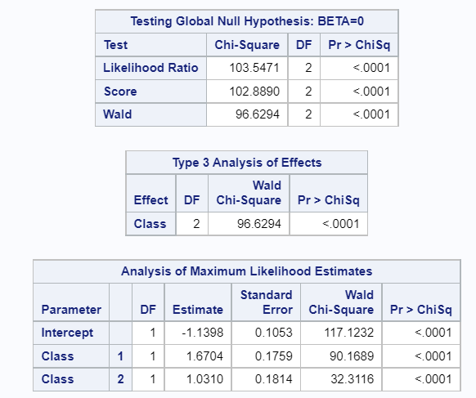
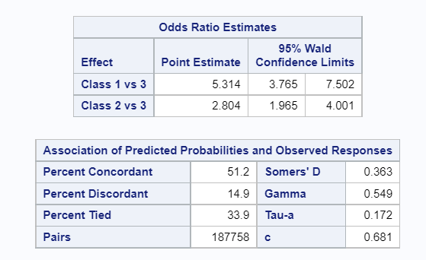

Slide 20
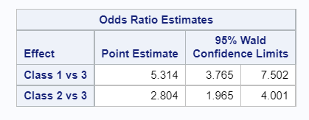
e) What is the estimated odds ratio? What is the interpretation?

Slide 21
Interpretation
The passenger in 2nd Class has 2.804 times odds of surviving than that of passenger in 3rd Class.
The passenger in 1st Class have 5.314 times odds of surviving than that of passenger in 3rd Class.
The Logistic Regression Model Accuracy is 51.2%

Slide 22
THANK YOU

